Slide 1
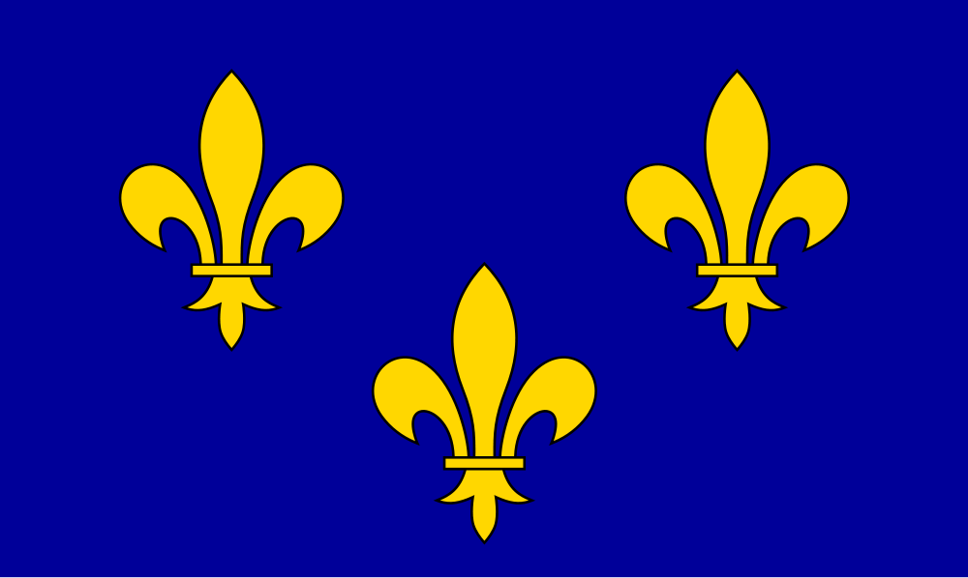
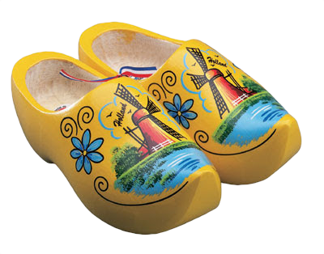
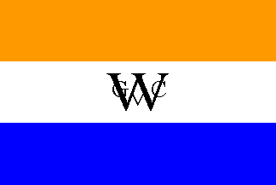
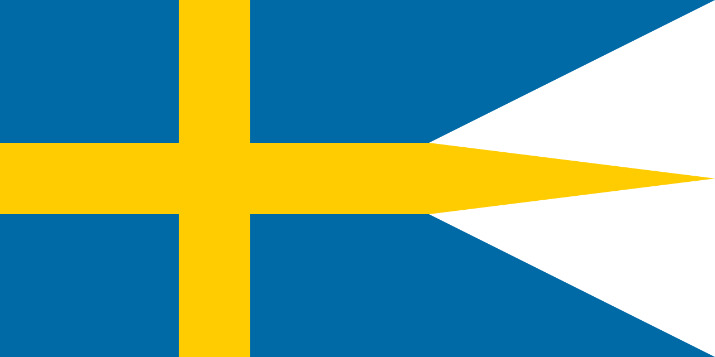
The French, Dutch, and Swedes

Slide 2
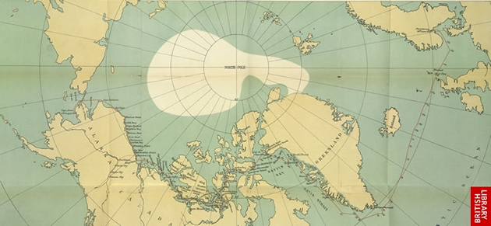
The Northwest Passage
A potential route from Europe to Asia, going north and west around America
Doesn’t actually exist, except for an icy route in arctic Canada
Most European nations will attempt to find it, including England, the Netherlands, and France

Slide 3
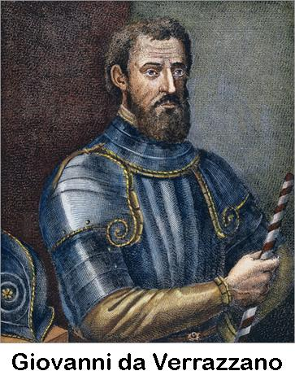
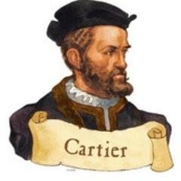
Jacques Cartier
Giovanni de Verazzano
Explored St. Lawrence River and claimed the area for France
Explored east coast of US

Slide 4
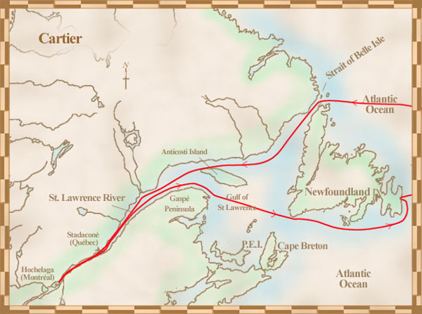

Slide 5
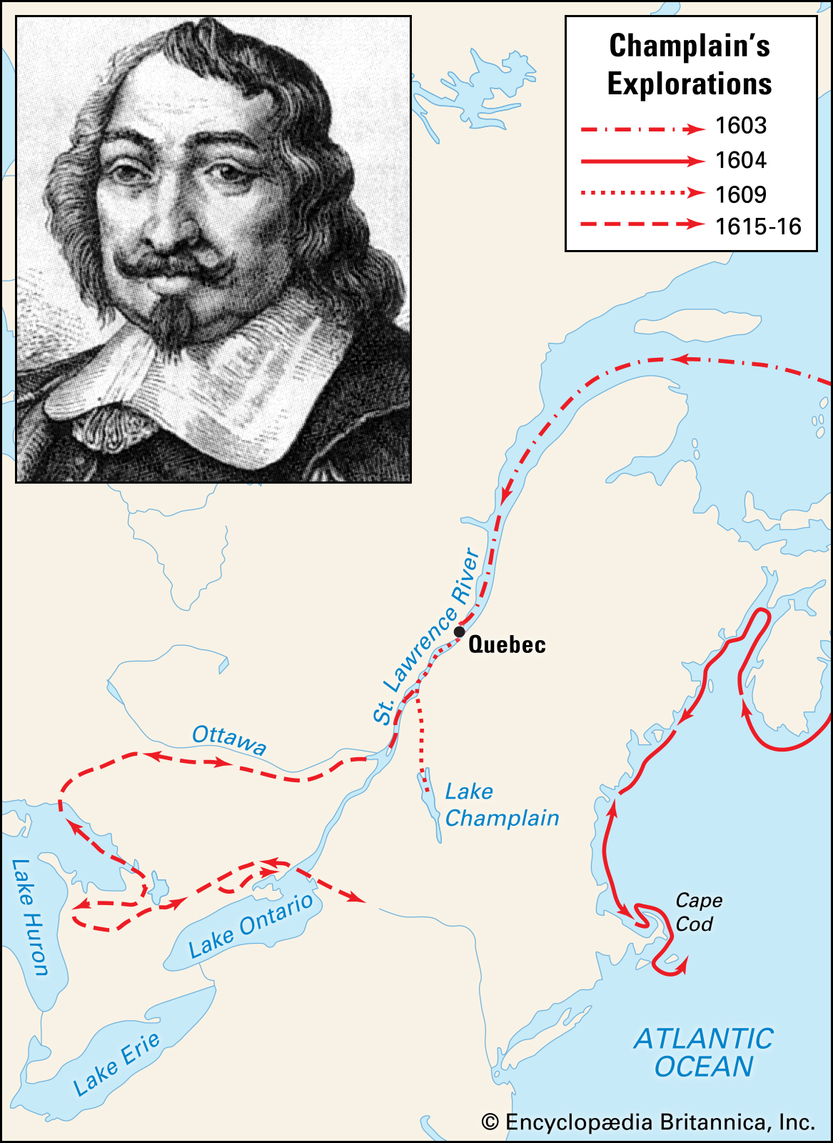
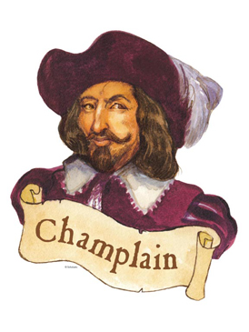
Samuel de Champlain
Explored and settled colonies in Canada (Quebec City), set up the French fur trade, and established relations with Native Americans
“Father of New France”

Slide 6
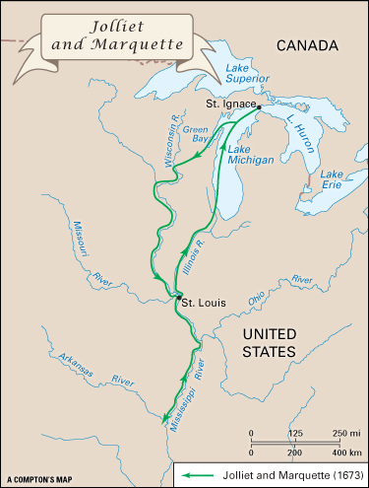
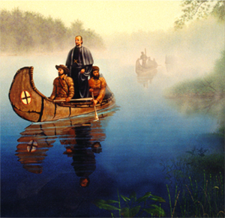
Marquette & Joliet
Priest and fur trader who explored Great Lakes and upper Mississippi River

Slide 7
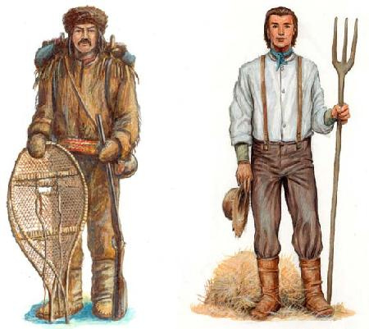
Coureurs de bois (“runners of the woods”): Men who tradedwith the Indians for furs, or trapped animals themselves. They often lived with the Indians and married Indian women

Slide 8
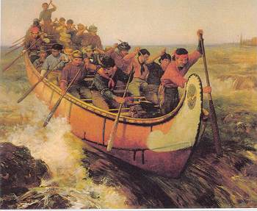
Voyageur: Originally Frenchmen sent to live with Indians, they were eventually men who worked for fur trading companies and transported furs by canoe

Slide 9
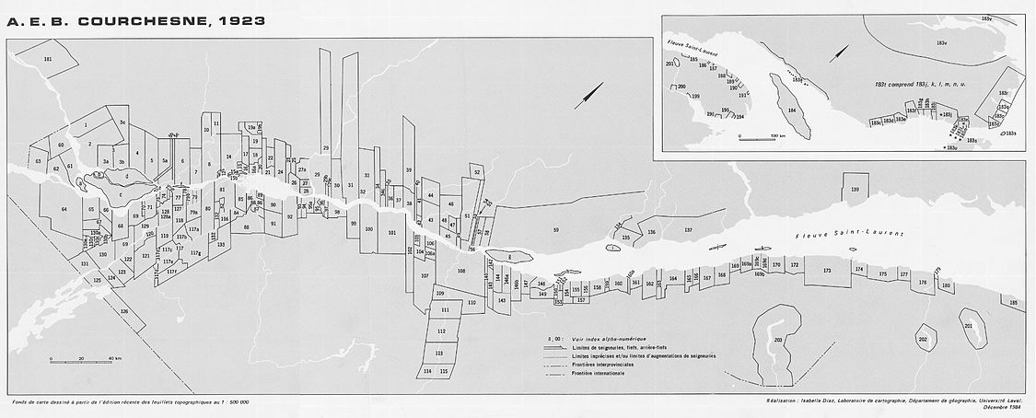
Seigneurs: Large landholders, meant to become feudal lords, who recruited habitants to work for them. Seldomly lived much better than anyone else.

Slide 10
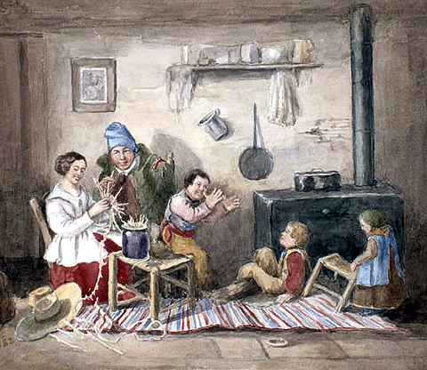
Habitant: farmers who lived in the St. Lawrence valley, usually growing wheat and raising pigs. Hired by, and worked for, the seigneurs

Slide 11
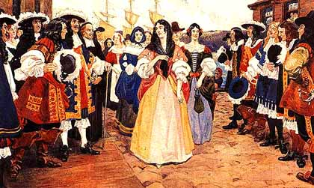
Filles du Roi (“daughters of the King”): women, usually poor orphans, who were sent to New France by the king to marry and start families.

Slide 12
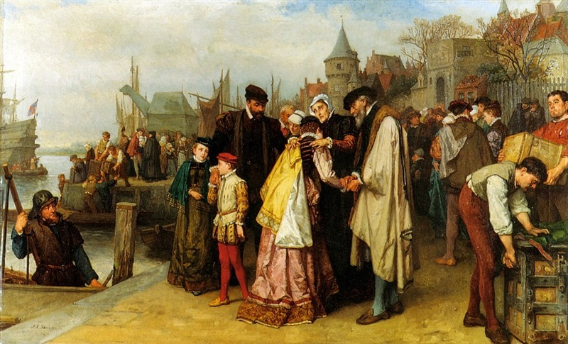
Huguenots: French Protestants, often persecuted at home. Many colonized the New World, “converting” to Catholicism if necessary, or settling in non-French colonies.

Slide 13
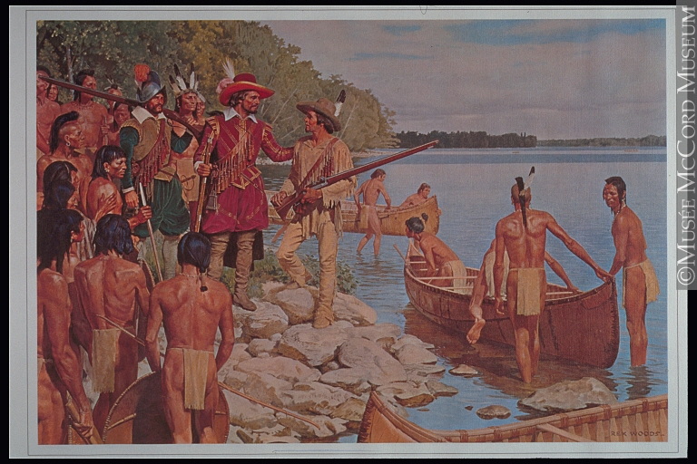
French America
French explorers and trappers explore and claim land around river valleys and the Great Lakes
-The French built outposts and forts throughout their colonies in North America for trading, communication, and defense.

Slide 14
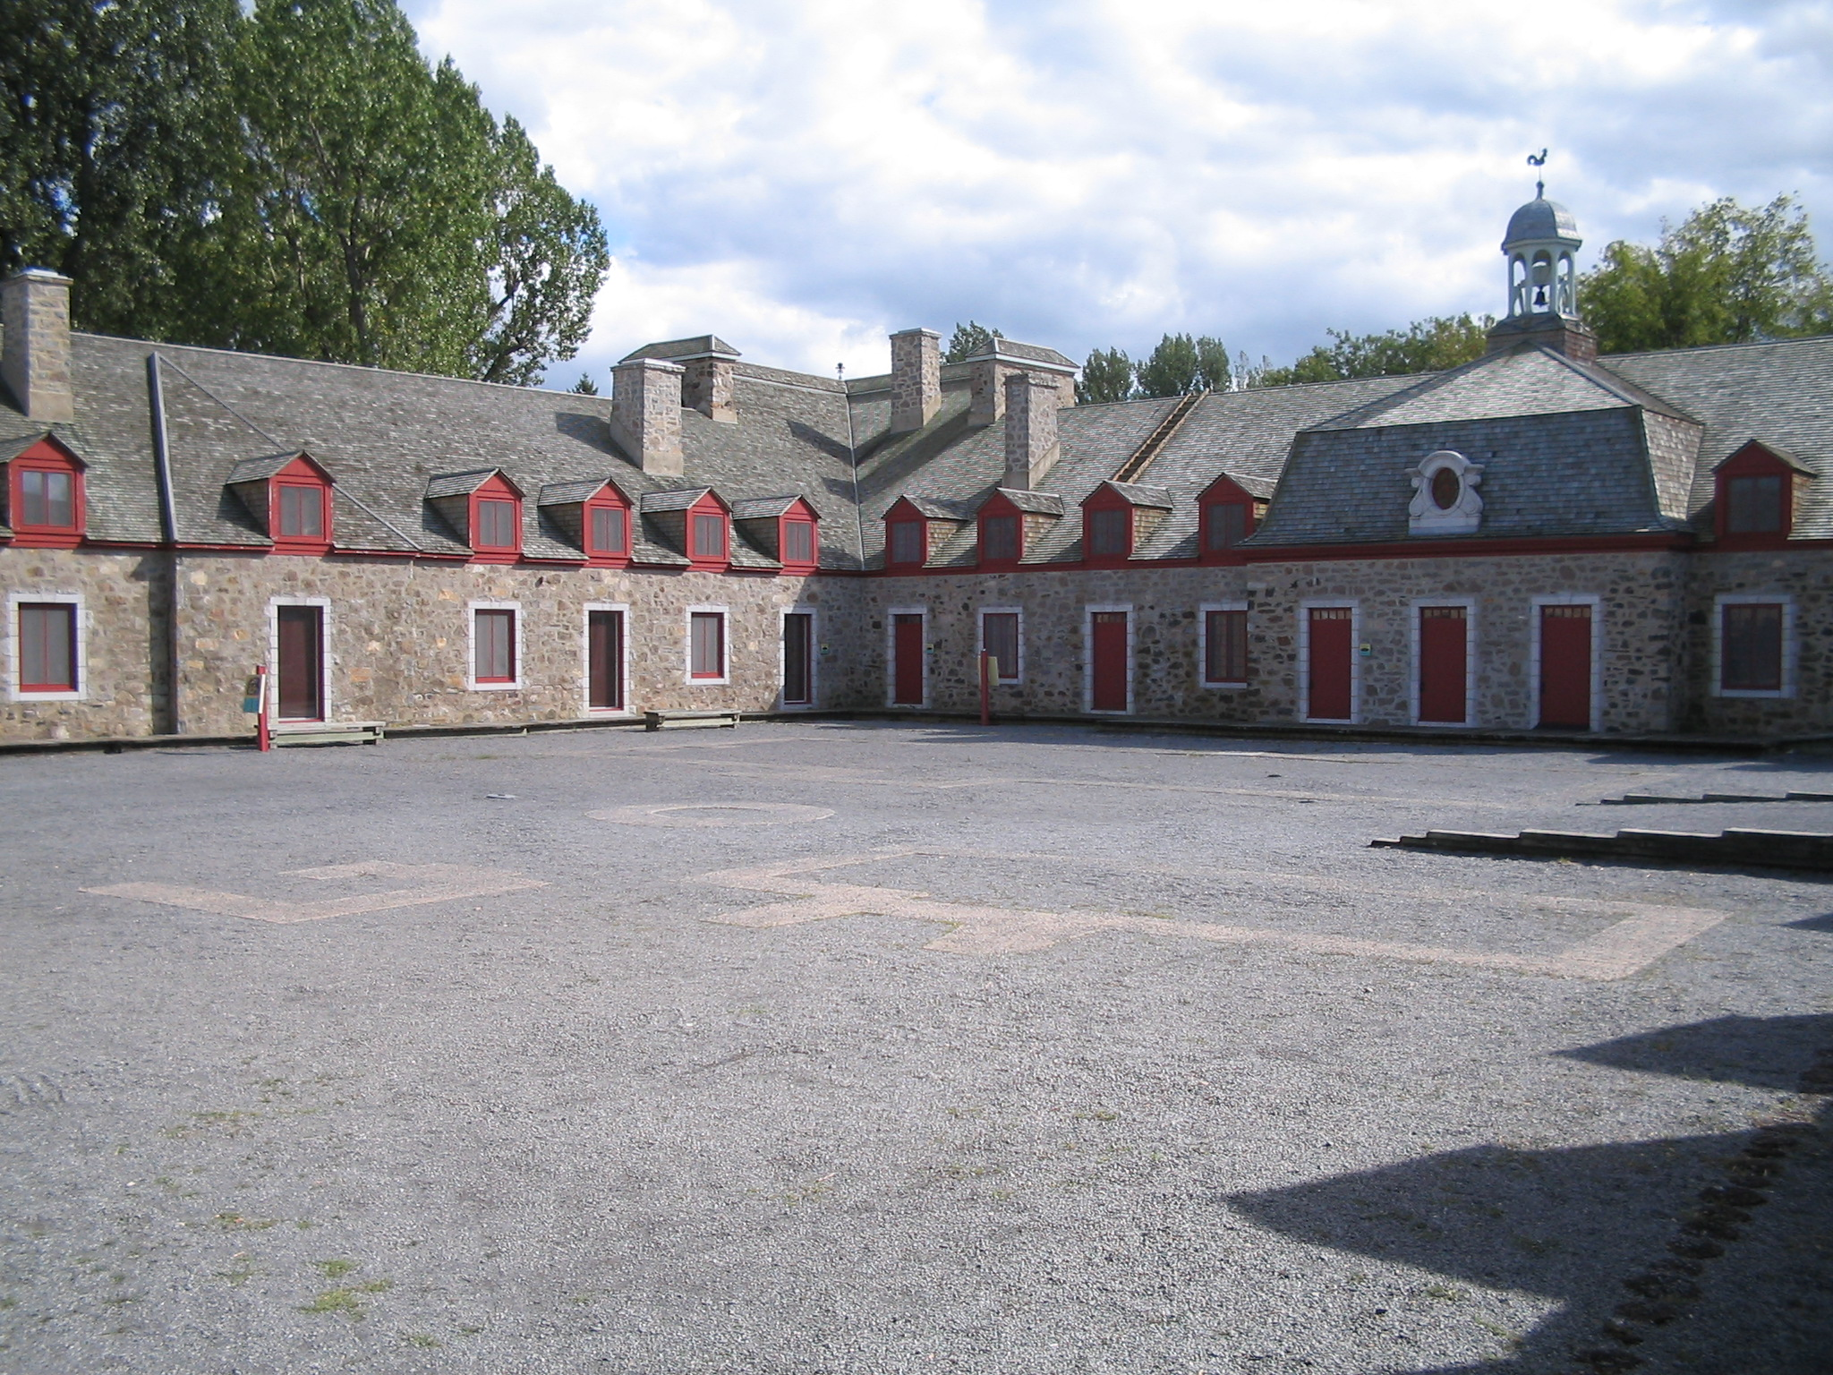
French America

Slide 15
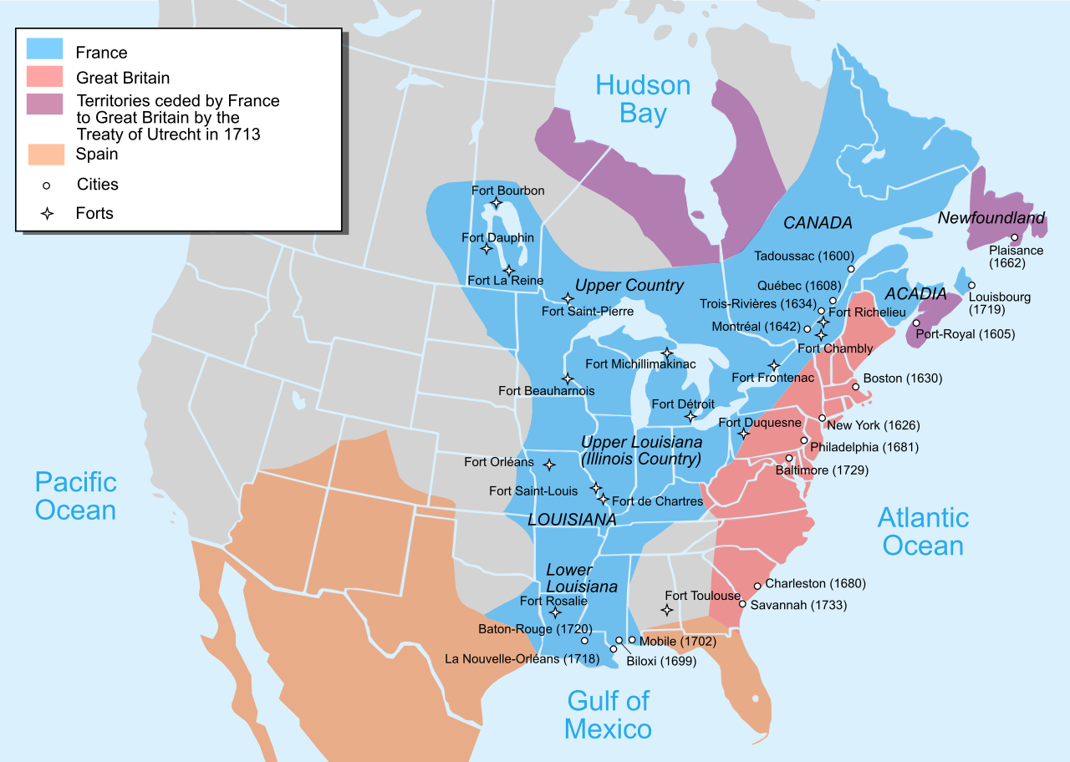
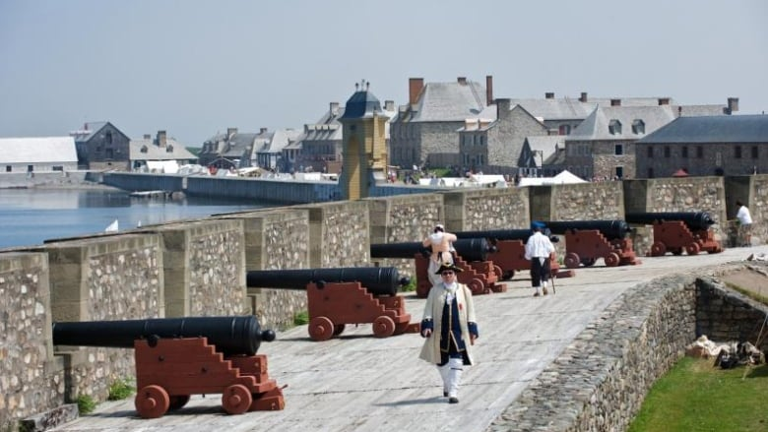
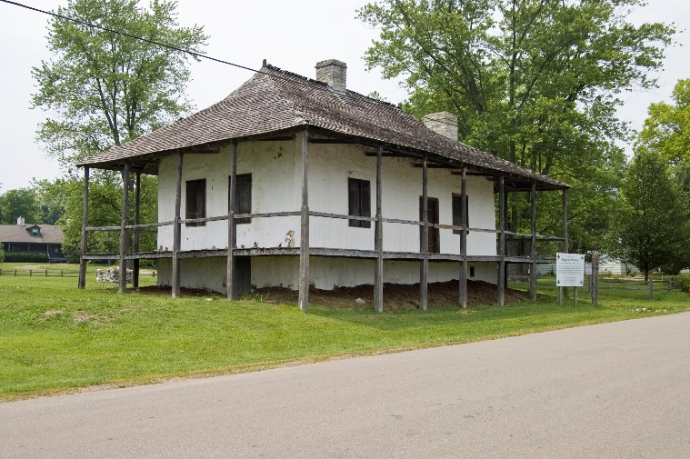
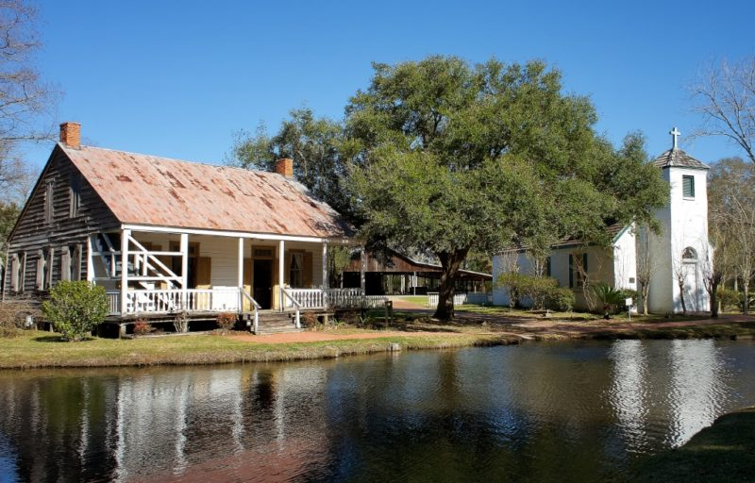

Slide 16
The Dutch

Slide 17
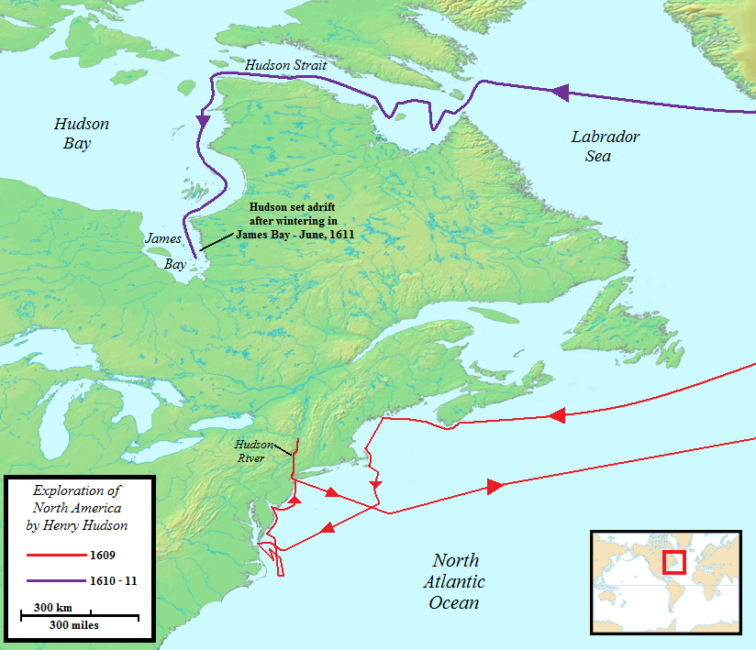
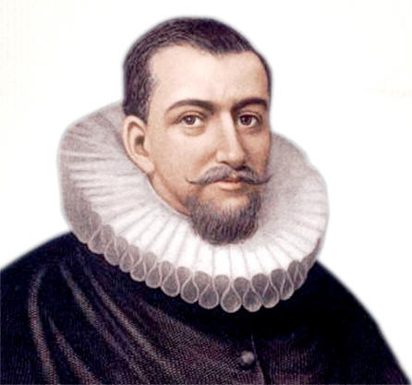
Henry Hudson
Explored east coast of US and arctic Canada, claimed Manhattan for the Dutch
I am bae.

Slide 18
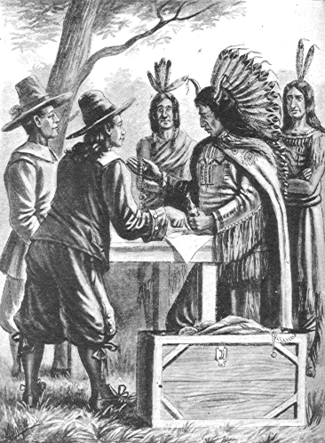
Dutch America
1624: Dutch leader Pieter Minuit starts a settlement at the mouth of the Hudson River and call it “New Amsterdam.” It will be the capital of their New Netherlands colony.

Slide 19
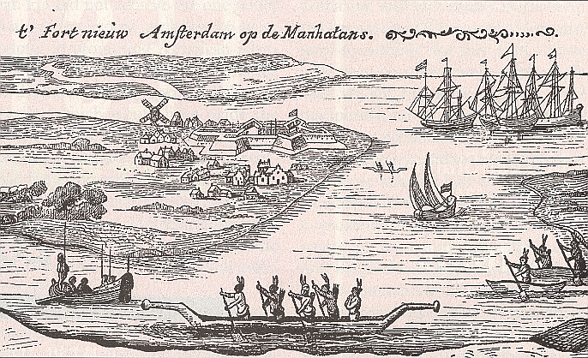
Dutch America

Slide 20
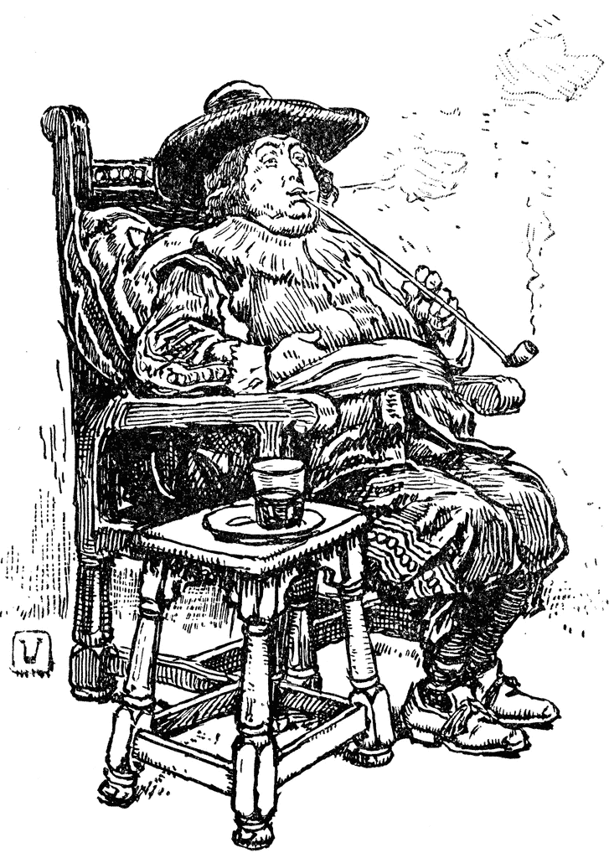
Dutch America
"Van Twiller was exactly five feet six inches in height and six feet five inches in circumference. His head was a perfect sphere, and of such dimensions that Nature, with all her ingenuity, would have been puzzled indeed to construct a neck capable of supporting it. Therefore, she had declined to try and had settled it firmly on the top of his backbone just between his shoulders. His body was oblong. His legs were short but sturdy in proportion to the weight they had to sustain; so that when standing he had much the appearance of a beer barrel on skids."
Wouter Van Twiller

Slide 21
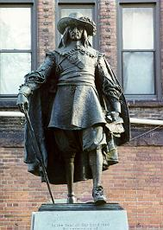
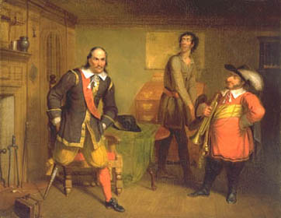
Pieter Stuyvesant: most famous governor of New Netherlands, and one of the most unpopular: religious intolerance, authoritarian, etc)

Slide 22
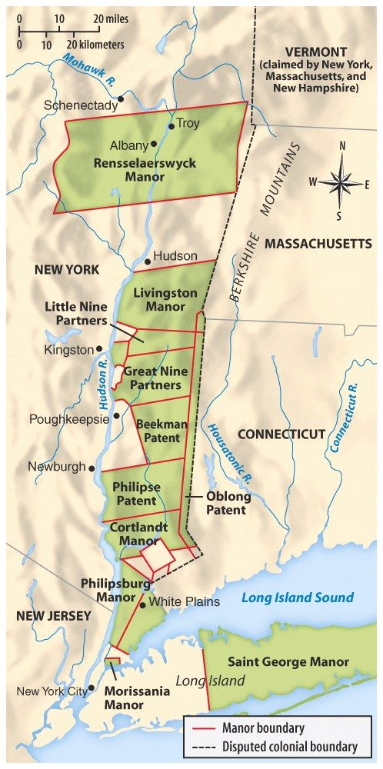
Patroonships
Patroon: A landholder who, under Dutch colonial rule, was granted ownership rights to a large tract of land in exchange for bringing 50 new settlers to New Netherlands.

Slide 23
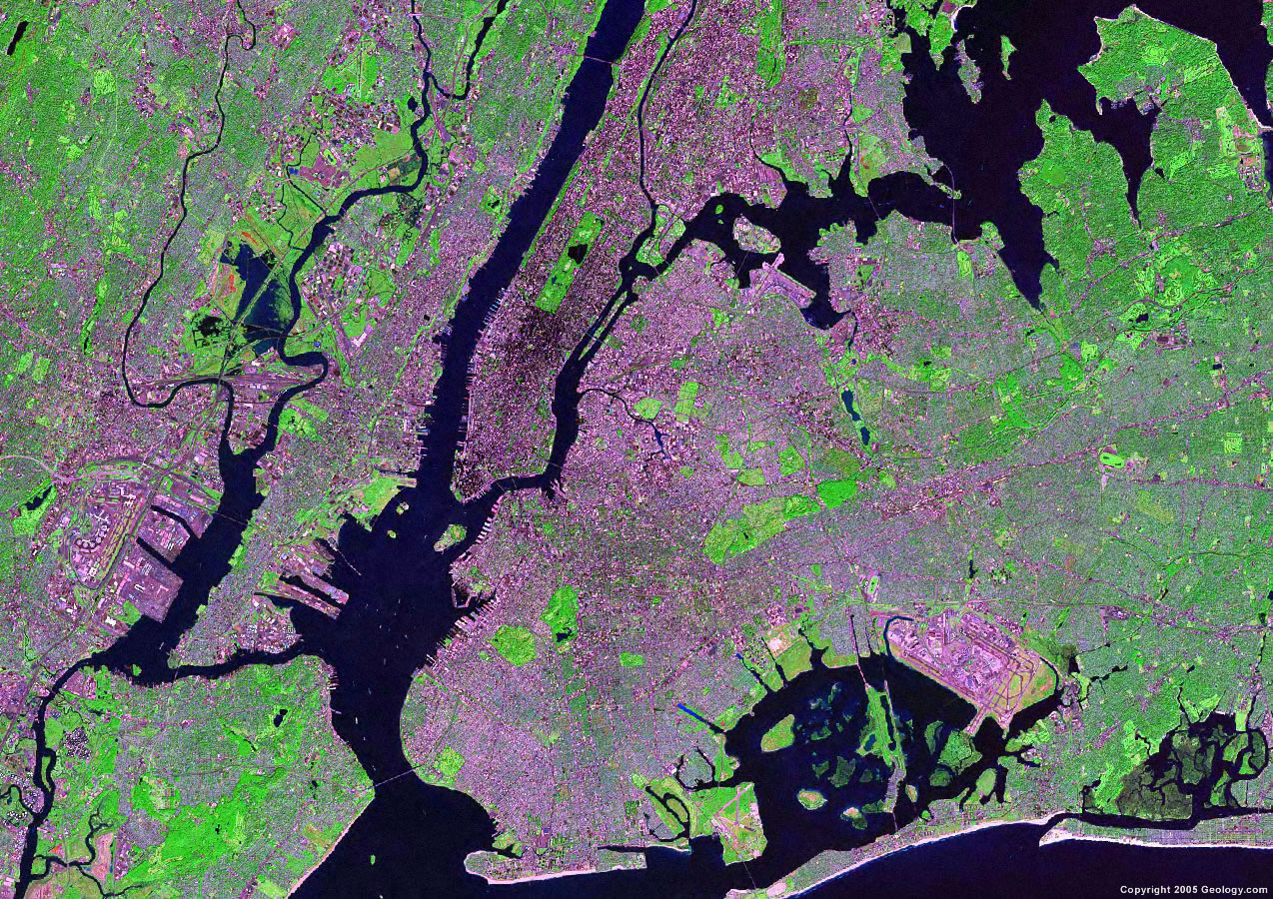
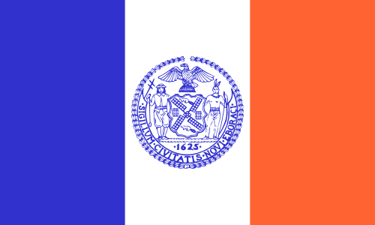
Dutch America
Yonkers
Bergen County
Bronx
Harlem
Nassau County
Flushing
Bowery
Kill van Kull
Brooklyn
Staten Island
Coney Island

Slide 24
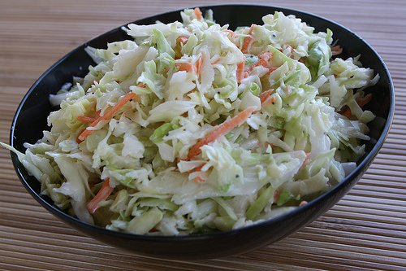
Dutch words we use today
Dutch America
BOSS
COLE SLAW

Slide 25
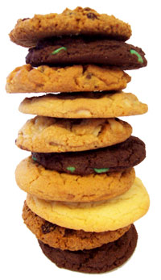
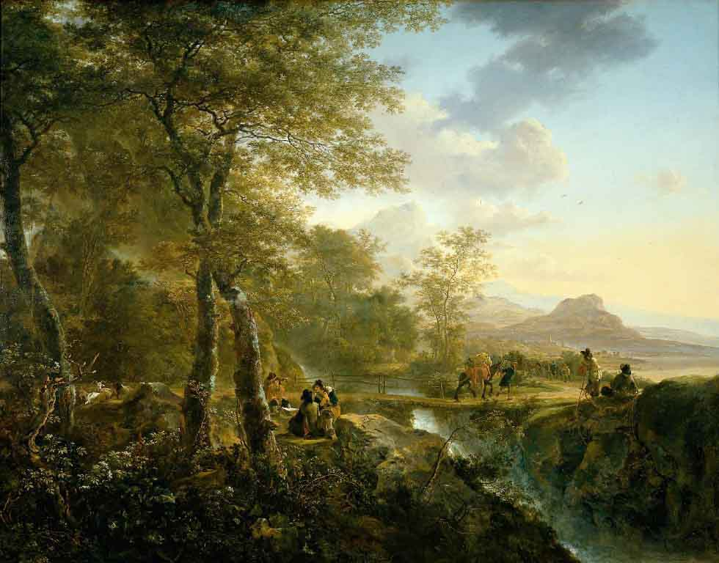
Dutch words we use today
Dutch America
LANDSCAPE
COOKIE

Slide 26
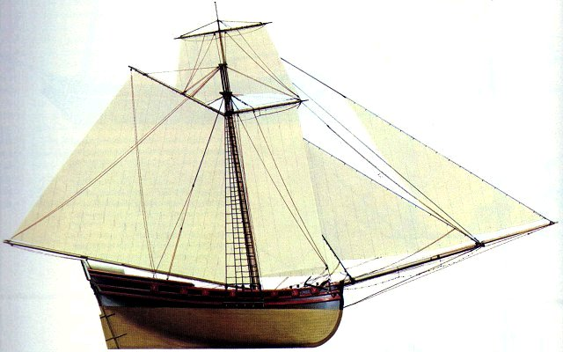
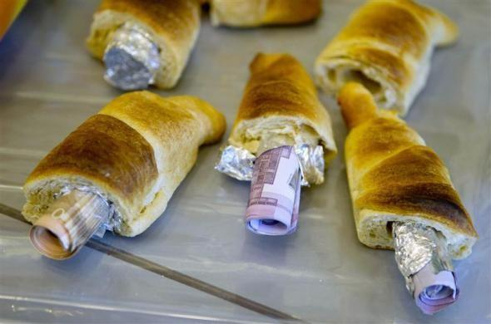
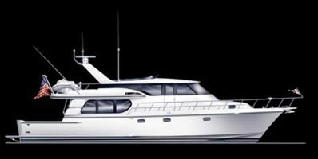
Dutch words we use today
Dutch America
SCHOONER
SMUGGLE
YACHT

Slide 27
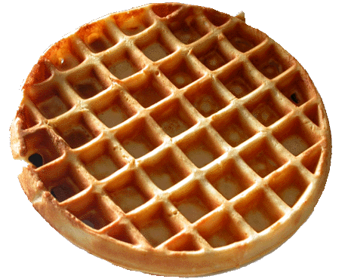
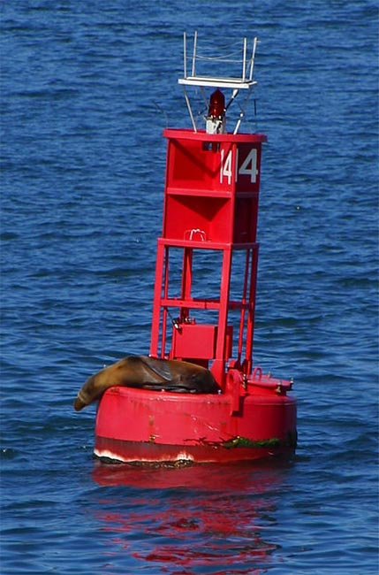
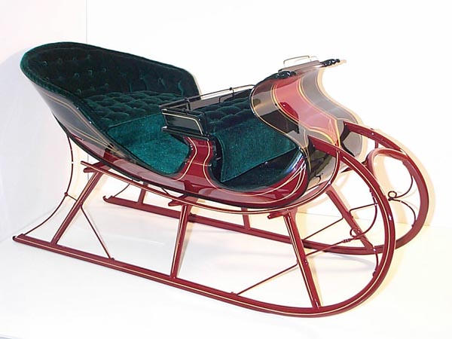
Dutch words we use today
Dutch America
WAFFLE
SLEIGH
SPOOK
BUOY

Slide 28
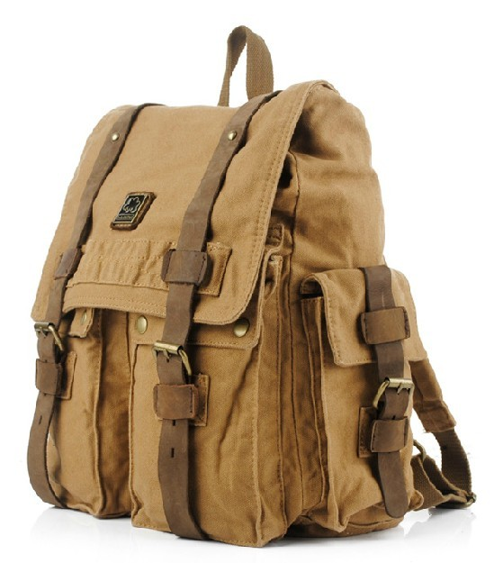
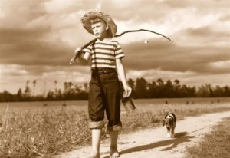
HOOKY
KNAPSACK

Slide 29
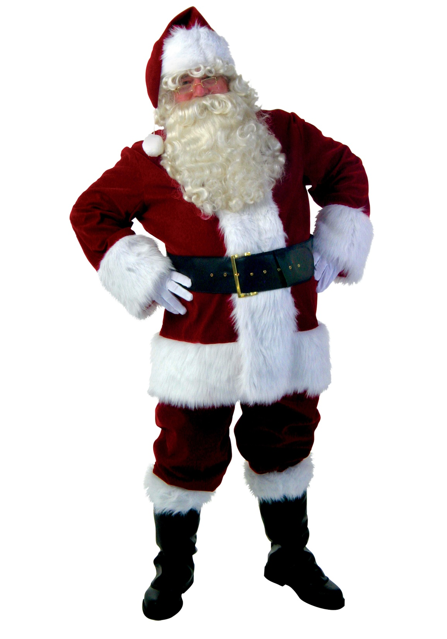

Slide 30
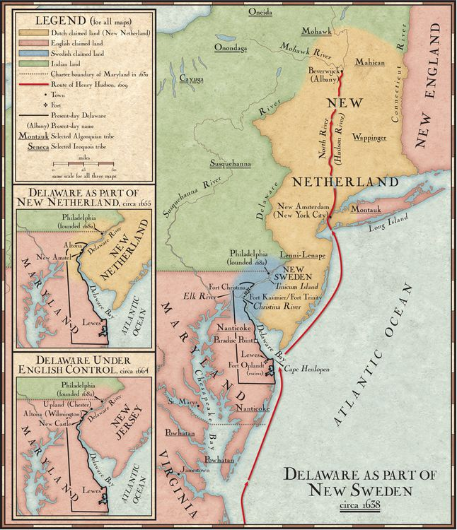
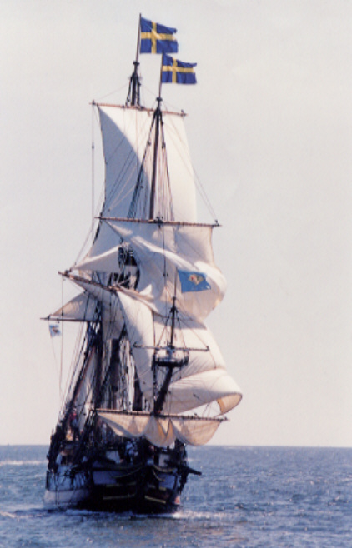
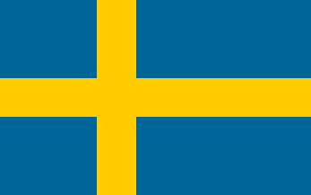
New Sweden was started by settlers from Sweden and Finland looking to make money in the fur trade.
They settled along the Delaware river, in modern-day Delaware.
The colony was not very successful, and was conquered by the Dutch in 1655.

Slide 31
